Slide 1
Microsoft Azure

Slide 2
Why consider the cloud?
Public Cloud Platform
$30
Speed
Scale
Economics
$25
$20
Market Share (in Billions)
$15
$10
$5
2008
2009
2010
2011
2012
2013
2014
2015
2016
2017
2018
2019
2020
Notes:
In the last few years, we have seen an explosive growth in the use of the public cloud. While most of the initial adoption was seen by startups and smaller orgs, most of the new growth will come from larger organizations adopting the public cloud.
Now you might ask what’s causing cloud adoption at such a fierce rate. There are 3 fundamentals business drivers at play here:
SPEED: With minutes instead of days/weeks to procure & provision servers, the pace of innovation has dramatically increased. Reduced ‘time to develop’ & ‘time to market’ means your IT can be much more agile in servicing needs of the business units or developers. Embrace & Enable Innovation. Help your business move forward against the competition. In fact, it is the speed and agility that IT hasn’t been able to provide has resulted in what many call “Shadow IT” where business units are resorting to using credit cards to procure computing resources outside of the purview of the IT.
SCALE: Cloud gives you an almost infinite set of computing resources. Your applications will enjoy massive global scale, and can easily scale up or down depending on the demand. That means, you never have to worry about running out of capacity or worry about overprovisioning. You use just enough resources for your needs - nothing more, nothing less.
ECONOMICS: And of course, you’re paying only for what you use in the Cloud. This in itself saves you money for any app that has variable computing needs. For some organizations, there is also an additional benefit of changing CapEX to OpEX, which frees up capital from infrastructure investments so it can be put to other uses.

Slide 3
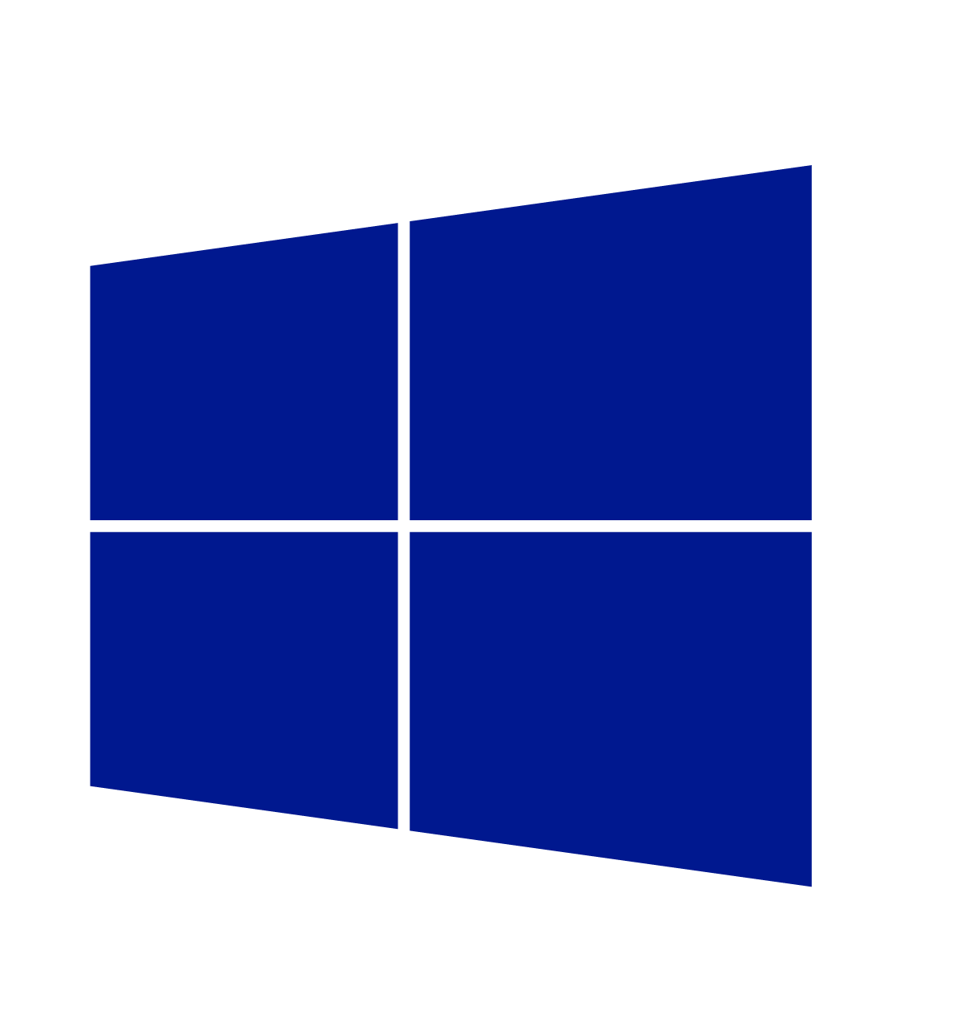
Cloud innovation presents challenges for IT
How do I integrate with my existing IT investments?
What about my heterogeneous, complex IT landscape?
What about security and compliance?
Notes:
But as you think about using the public cloud, there are some top of mind issues you have to reckon with.
If you’re like most organizations, you have your existing servers and IT infrastructure (either on-premises in your own datacenters or in 3rd part colocation facilities). You also have an IT staff to manage these assets. So as you think about using the public cloud, you’re not thinking of it in a silo – ideally where possible you’d want to integrate the public cloud with existing IT, manage it no differently, and even have applications with parts running on and off-premises. Latest IDC findings show 40% of enterprises are already adopting hybrid clouds today (source - http://www.infosys.com/newsroom/press-releases/Pages/cloud-ecosystem-integrator.aspx).
You’re also probably running a variety of OSs, databases, middleware and toolsets from multiple IT vendors. Your developers are proficient in multiple languages and your apps are written in multiple languages and frameworks. In other words, your IT environment is complex and heterogeneous. And you want to make sure the cloud you choose is able to handle your heterogeneous needs.
Next you have to abide by a bunch of security and compliance initiatives. The rest of the business trusts your IT org to run apps in a secure and reliable manner. So you want to make sure the public cloud platform and the vendor who provides the service is using is trustworthy, i.e. has the right experience and expertise, and has necessary SLAs, and security controls in place.

Slide 4
Enterprise needs
Integration
Heterogeneity
Security
On-premises and Cloud
Broad and flexible
Secure and reliable
Notes:
Let’s see what you as enterprise customers uniquely expect from a public cloud platform. These are “must haves”:
Integration – So you can integrate with your existing apps and infrastructure.
Heterogeneity - So you can continue to support multiple languages, frameworks, OSs
Security – So you continue to run your enterprise apps securely and reliably
Windows Azure, our public cloud offering, addresses these needs. Windows Azure is built on three core fundamentals:

Slide 5
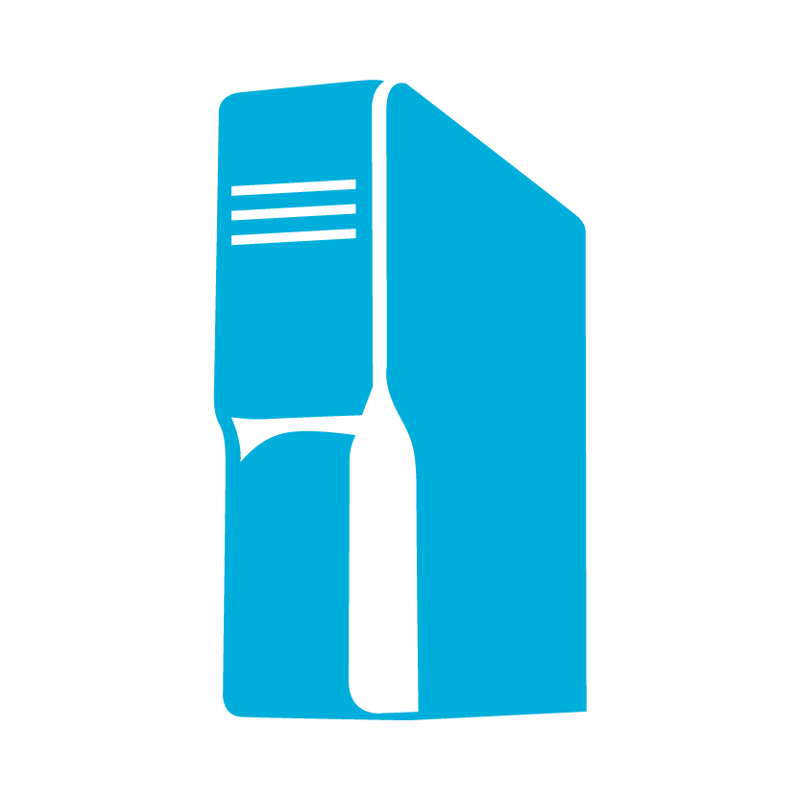
Enterprise needs
Virtualization
Integration
Identity
Data
Platform
On-premises
Cloud
Microsoft Azure fundamentals
On-premises AND Cloud
Development
DevOps and mgmt
Notes:
On-premises AND Cloud: We believe in a world where you’re integrating public cloud with your on-premises infrastructure, and using each where it makes sense, in conjunction with each other. Think and, not or. It’s not an on-premises OR cloud proposition – it’s an AND proposition. And when we say integration, we mean true integration – across infrastructure, apps, identity, and databases. This is what we call hybrid.
Microsoft is the only company which has the necessary assets across virtualization, identity, data platform , development and management to provide a consistent experiences across on-premises, our cloud and 3rd party service providers. This vision and strategy - called “Cloud OS” – is what we aim to deliver for our customers. If you choose look at other Cloud vendors that provide public OR private cloud offerings (Amazon, VMware, or Google), you have to cobble together disparate offerings and you will not get a seamless experience.

Slide 6





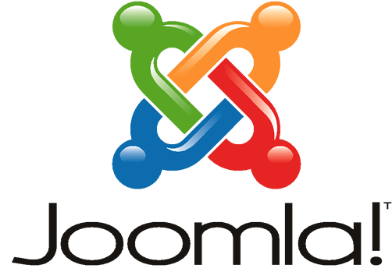
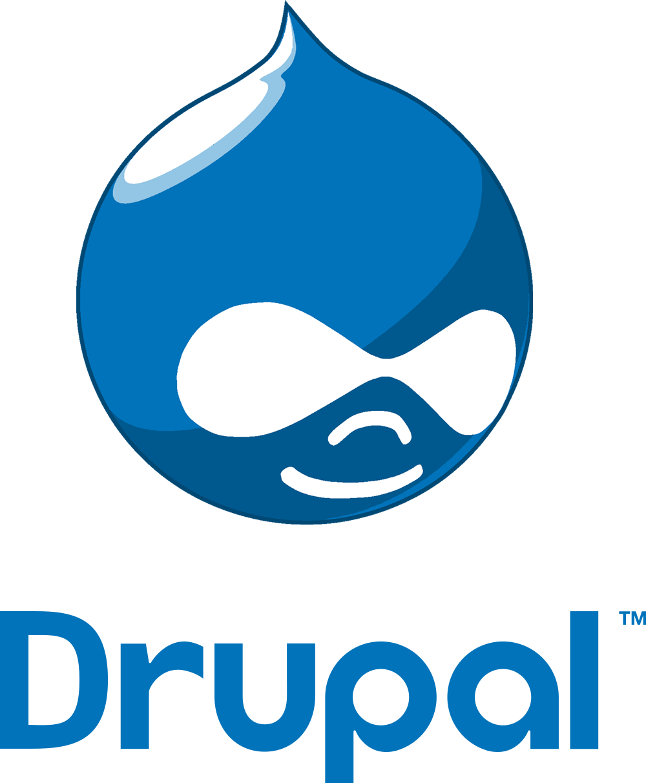





Enterprise needs
Heterogeneity
Integration
Languages
CMS
Devices
Databases
Microsoft Azure fundamentals
Operating
Systems
Open, Broad
and Flexible
On-premises AND Cloud
Notes:
Open, Broad and flexible: We realize that you’ll want to run a variety of workloads in the cloud. In Windows Azure, we will of course provide first and best experience and support for Microsoft workloads, but at the same time we have embraced other open technologies so you get a cloud experience that satisfies your heterogeneous needs.
In enterprises, Java and .NET are still most used, but developers are also using PHP, Python and other languages in addition. Windows Azure supports all these languages and more.
Windows Azure provides out-of-the box experience for open frameworks like Hadoop, web frameworks like Wordpress, Joomla and Drupal. We also provide first party SDKs for developing apps using Android, IOS or Windows phones.
We not only support, but have embraced open technologies.
We also provide a broad set of services that provide you a good choice. In addition to the breadth of the platform, it’s important to note that using Windows Azure is not an all or nothing proposition. You can use most services independently of each other. For example, you can just use storage without compute or use DB without using storage. What you want to use and how you want to use is really YOUR choice.

Slide 7
Enterprise needs
Heterogeneity
TRANSPARENCY
Security
Languages
CMS
Devices
Databases
Microsoft Azure fundamentals
Operating
Systems
Open, Broad and Flexible
Trustworthy
Notes:
As you take the journey into the Cloud, you need a secure and trustworthy platform. And you need someone who’s committed to the Cloud.
Let’s talk about the three things that makes Windows Azure and Microsoft a trustworthy platform: Transparency, Relationship and Experience

Slide 8
TRANSPARENCY
Enterprise needs
RELATIONSHIP
EXPERIENCE
Security
Trust through transparency
ISO 27001 Cloud Security Alliance (STAR)
Industry standards
Regulatory compliance
Trust center
$
Monthly SLAs
Yearly audits
Independently verified
Real-time status
Service dashboard
Microsoft Azure fundamentals
Trustworthy
Notes:
We believe in Trust through Transparency. We are transparent in the following ways:
We participate in industry standards like ISO 27001, SSAE16 and Cloud Security Alliance.
We undertake yearly audits with independent 3rd parties
We provide a rich set of financially backed monthly SLAs (this differentiates us from other cloud providers like AMZN whose SLAs are fewer and annual). Monthly SLAs are more stringent with less room for error than yealy SLAs
All of our regulatory compliance and privacy policies are clearly explained in the online portal called Trust Center
We provide real time status of all the services via a Service Dashboard. We provide Root Cause Analyses in case of issues.

Slide 9
Enterprise needs
TRANSPARENCY
RELATIONSHIP
EXPERIENCE
Security
Count on your existing relationship
Attach to your EA
Enterprise ready procurement
24x7x365
Enterprise-ready support
MCS, CSS, Partners
Trusted advisors
Microsoft Azure fundamentals
Trustworthy
Notes:
With Microsoft and Windows Azure, you’re relying on you existing relationship and account team to procure and get support.
Azure can be a part of you existing Enterprise Agreement you have in place with Microsoft. This way, you don’t have to negotiate and sign up for yet another agreement with another vendor.
We support Azure and other Microsoft software that you use just the same way. When you run Microsoft workloads on other cloud platforms, you might not get the same level of support. You’ll be relying on a single point of support for you infrastructure and software with Microsoft and Windows Azure
We have an Azure practice in MCS, and continue to be your trusted advisors as you start your journey with the Cloud.

Slide 10
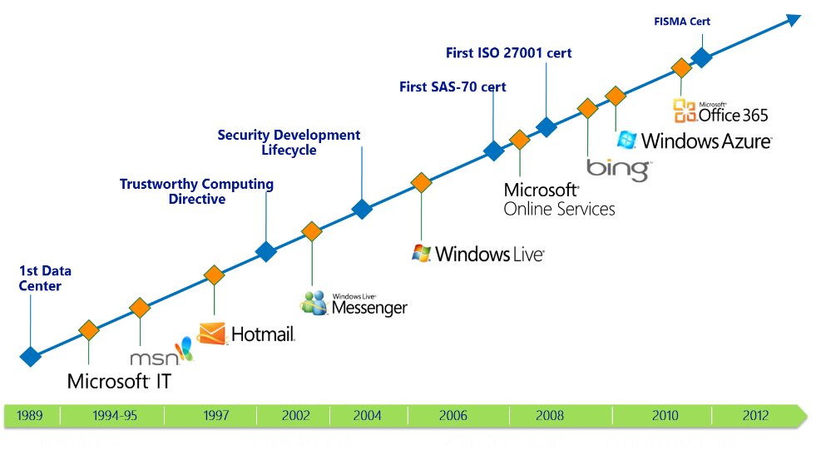
Enterprise needs
TRANSPARENCY
RELATIONSHIP
EXPERIENCE
Security
Unparalleled experience in online security
Microsoft Azure fundamentals
Today, we manage 200+ global services, running 24x7
9.9 billion messages a day via Windows Live Messenger
600 million unique users monthly on Windows Live and MSN
1 Petabyte+ of updates served monthly Windows Update
5M LiveMeeting conference minutes per year
200 billion+ authentications through Windows Azure AD
Trustworthy
Notes:
Windows Azure is not our first foray into Cloud Computing. We have been doing this for more than two decades, and have the deepest experience in the industry.
Our first datacenter was in 1989. Since then, we have run some of the largest global services securely and efficiently – Bing, Office 365 and Hotmail just to name a few.
Today, we run over 200+ global services 24x7 and here are some stats to show you how large scale and global our operations are.
Windows Azure is operated in the same manner by the same teams as some of these other global services. You can rest assure that security and operational efficiency is at our core.

Slide 11
Microsoft Azure delivers.
Enterprise ready by design.
Integration
Heterogeneity
Security
On-premises
AND cloud
Open, Broad, Flexible
Trustworthy
On-premises and Cloud
Broad and flexible
Secure and reliable
WHAT IS AZURE..?
Notes:
Let’s pause and summarize the design principles that make Windows Azure a true enterprise ready platform.

Slide 12
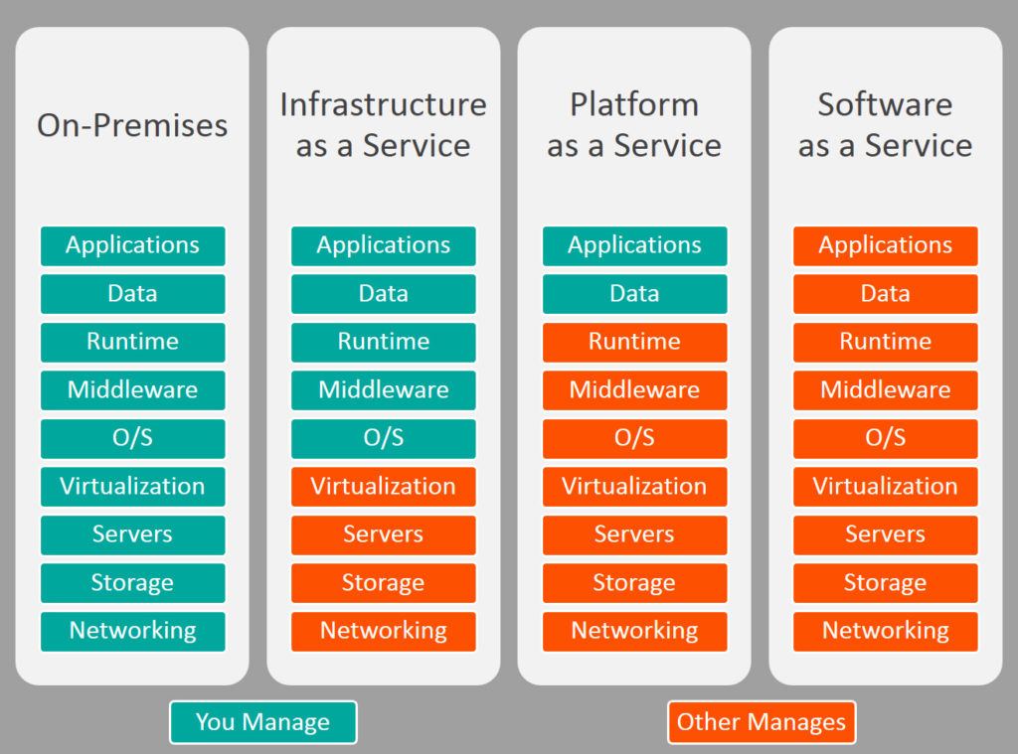

Slide 13
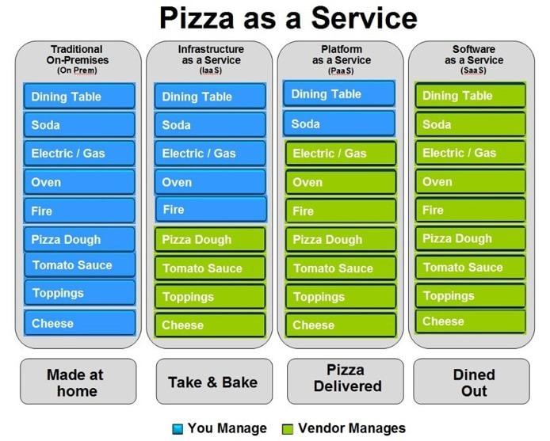

Slide 14

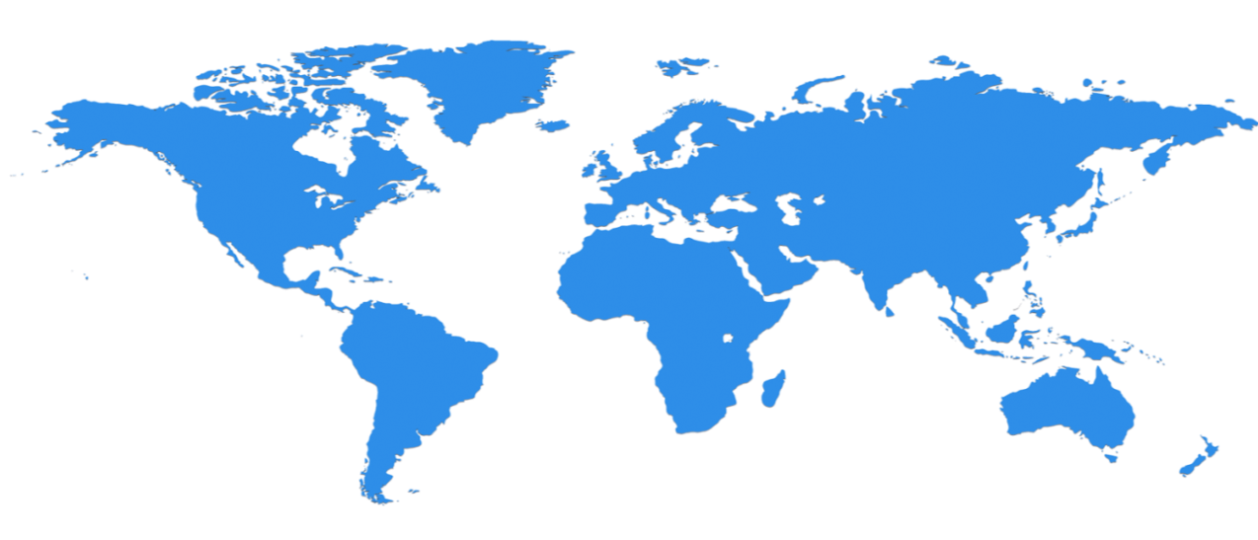

Huge infrastructure scale is the enabler
40+ Regions ONLINE…huge datacenter capacity around the world…and we’re growing
North Europe
Ireland
West Europe
Netherlands
Central US
Iowa
North Central US
Illinois
US Gov
Iowa
China North *
Beijing
East US
Virginia
Japan East
Saitama
West US
California
China South *
Shanghai
East US 2
Virginia
Japan West
Osaka
India West
TBD
India East
TBD
South Central US
Texas
US Gov
Virginia
East Asia
Hong Kong
SE Asia
Singapore
Australia East
Sydney
Brazil South
Sao Paulo
100+ datacenters
One of the top 3 networks in the world (coverage, speed, connections)
2 x AWS and 6x Google number of offered regions
G Series – Largest VM available in the market – 32 cores, 448GB Ram, SSD…
Australia West
Melbourne
Operational
Announced
* Operated by 21Vianet
Notes:
Over the last few years we’ve truly delivered a huge infrastructure to enable us to grow our services at scale around the globe. Whether it’s our flagship facilities in Quincy, Washington or Boydton, Virginia, or some of the newly announced facilities in Shanghai, Australia and Brazil, it really is key for us to make smart investments around the world to deliver services in a resilient and reliable fashion.
A lot of people ask, what goes into site selection at Microsoft and how do we decide where to place our datacenter investments? There are over thirty-five factors in our site selection criteria. But really, the top elements are around proximity to customers and energy and fiber infrastructure, insuring that we have the capacity and the growth platforms to be able to grow our services.
Another key element is about skilled workforce. We need to insure that we have the right people to run and operate our datacenters on a day to day basis.

Slide 15
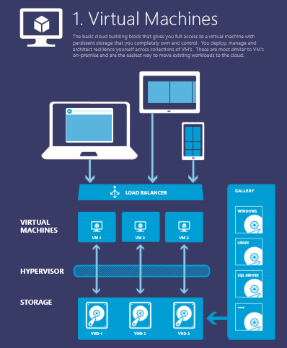
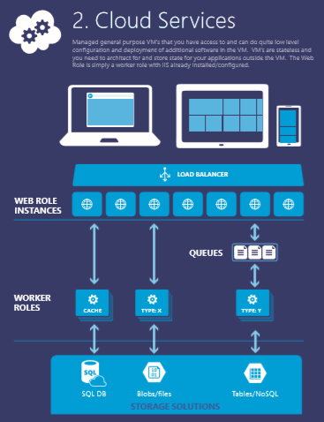
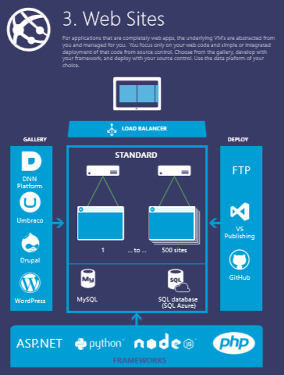
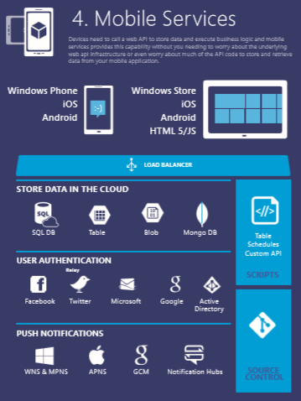
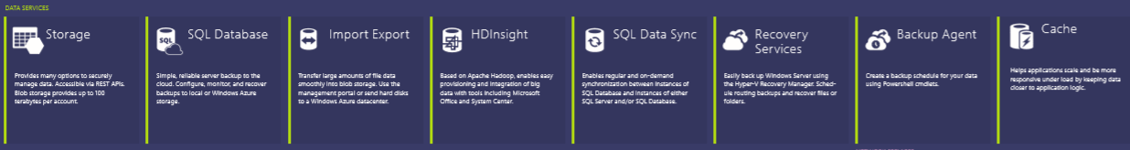



Notes:
You can use this to explain all the Azure building blocks – the compute services at the top and then the other blocks of services – data, networking, Apps…. OR you can go with the next set of slides… YOUR CHOICE…

Slide 16























^{app} ^{services}
cloud services
caching
identity
service bus
media
mobile services
web sites
integration
hpc
analytics
^{data} ^{services}
SQL database
HDInsight
table
blob storage
^{infrastructure} ^{services}
virtual machines
virtual network
vpn
traffic manager
cdn
Notes:
Windows Azure is a broad stack of services that runs in our datacenters globally.
Think of the different services as building blocks. These services can be categorized into three classes –
Infrastructure services which are lower level building blocks,
Data services that provide storage and data management capabilities to apps, and
App services which provide different capabilities to rapidly develop apps, scale and run apps at a global scale.

Slide 17
^{app} ^{services}
cloud services
caching
identity
service bus
media
Apps
mobile services
web sites
integration
hpc
analytics
^{data} ^{services}
SQL database
HDInsight
table
blob storage
caching
identity
cloud services
table
^{infrastructure} ^{services}
virtual network
virtual machines
virtual network
vpn
traffic manager
cdn
Notes:
You can use these blocks or puzzle pieces to rapidly build apps, and then choose an Azure datacenter to run the app. Windows Azure takes care of the underlying management, and provides your app the scale it needs.
This approach is what industry experts call a Platform as a Service.

Slide 18

Azure datacenters,
your datacenters.
^{app} ^{services}
cloud services
caching
identity
service bus
media
web sites
integration
hpc
analytics
virtual machines
virtual network
mobile services
vpn
^{data} ^{services}
SQL database
HDInsight
table
blob storage
^{infrastructure} ^{services}
virtual network
virtual machines
virtual network
vpn
traffic manager
cdn
vpn
Notes:
But that is not all that you can do with Azure. Windows Azure also provides infrastructure services which allow for more hands on configuration and management similar the servers you have today. However, they’re hosted in Microsoft datacenters letting you use Azure as if you were operating your own datacenter in the Cloud. For example, you can provision VMs, give them private IP addresses, and connect to them using a VPN from your on-premises environment. Most importantly, this lets Windows Azure mimic your on-premises datacenter and run your current apps with little or no change without the expense of having to own servers of racks, cooling and building costs. Furthermore, you can connect the “datacenter” you build in the Cloud to your on-premises datacenter so the datacenter in the Cloud becomes an extension to your on-premises infrastructure.
These “building blocks” lets Windows Azure to be used as an Infrastructure-a- a-service.
So, you see Windows Azure offers IaaS +PaaS in one platform. IaaS provides flexibility, PaaS eliminates complexity. Use PaaS where you can, use IaaS where you need. With Azure, you can use both together or independently, and build apps of the future. That uniquely differentiates us.

Slide 19
Store, backup, recover your data
Cloud Storage
Opportunity
Capacity
Data grows exponentially (50 – 60% Annually)
However most I/O happens to the “Working Set” data
Local Storage
SAN storage cost = 4x Cloud storage
(source: Forrester)
Time
Notes:
Store, Backup, Recover
Let’s first understand why Cloud makes for a great storage option? A typical organization increases their data storage by 50-60% every year (source:IDC). But only a small portion of the data is frequently accessed or used. So using purely on-premises storage like SAN/NAS solutions for that data is expensive. Forrester’s study placed a cost of about $95 per GB of data per year for an on-premises SAN solution which is 4X the cost of putting a GB in the Cloud. Of course, not all data can be put in the Cloud for performance or compliance reasons but where you can, using Azure for all backup and archived data, as well as less frequently accessed primary data makes a great business case.

Slide 20
Store, backup, recover your data
Azure Storage
10 Trillion Objects
“Azure Blob storage has taken a significant step ahead of last year’s leader Amazon S3, to take the top spot”
– Nasuni 2013 Cloud Storage Report
Notes:
Let us now understand the Windows Azure storage system and some of its salient features.
Treat Windows Azure as a giant “hard drive”. Why do we call it a giant? Windows Azure Storage has over 10 trillion objects, processes an average of 270,000 requests per second, and reaches peaks of 880k requests per second!
Windows Azure Blob storage is actually the top most rated by Nasuni Cloud storage report. This ranking is based on a number of factors like read/write speeds, availability and performance metrics.

Slide 21
Store, backup, recover your data
Microsoft Azure Storage
Highly durable and scalable
Multiple copies of your data
Financially backed SLAs
Storage for objects, tables, drives
Supports REST APIs
Notes:
We make 3 copies of data for durability and availability. So if a rack or server goes down, you data is available and accessible. We provide 99.9% SLA for storage.
Windows Azure Storage system is the underpinning to everything in Azure that requires storage. The Windows Azure storage system provides a solid robust data platform for different services that make use of it – Blobs, Tables and Drives.
Use Blob service for storing large amounts of unstructured data that can be accessed from anywhere in the world via HTTP or HTTPS. A single blob can be hundreds of gigabytes in size, and a single storage account can contain up to 100TB of blobs. Common uses of Blob storage include: Serving images or documents directly to a browser, Storing files for distributed access, Streaming video and audio, Performing secure backup and disaster recovery, Storing data for analysis by an on-premises or Windows Azure-hosted service
Tables is a NoSQL datastore which is ideal for storing structured, non-relational data. Common uses of the Table service include: Storing TBs of structured data capable of serving web scale applications, or storing datasets that don’t require a full fledged relational DB.
Drives are what are attached to VMs. They automatically provide get the same durability and availability. This differentiates us from other competitive offerings (like AWS) that have less reliable and durable storage systems for their VM instances.

Slide 22
Store, backup, recover your data
Microsoft Azure Storage
Defend against regional disasters.
East DC
> 400 miles
West DC
Geo replication
Notes:
Additionally, data is asynchronously copied to another datacenter that’s at least 400 miles away.
So you can be sure that every piece of data that you store in the Azure Blob is available as well as protected against regional disasters (we call this geo-replication).
Geo replication is a unique feature, that differentiates us from competition.

Slide 23
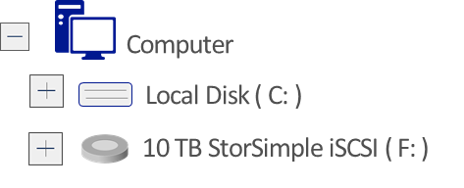

Store, backup, recover your data
Simple and fast on-ramp to Azure
Active data instantly available locally
Archives less used data to Windows Azure
Recover data from any internet connection
Reduce enterprise storage TCO by 60-80%
Physical or Virtual Servers
StorSimple
Your Data Center
Notes:
Azure Blob supports REST APIs so you can use it directly and build tools to integrate, but there are several ways you can use Windows Azure storage to integrate with your on-premises datacenter environment:
StorSimple Cloud-integrated Storage – StorSimple systems combine the data management functions of primary storage, backup, archive and disaster recovery with seamless Windows Azure integration – enabling a hybrid cloud storage solution through a single system and Windows Azure.
StorSimple systems use Windows Azure as an automated storage tier, offloading capacity management burdens and ongoing capital costs, while providing enterprise-grade local performance for active data sets. Using local and cloud snapshots, application-consistent backups complete in a fraction of the time needed by traditional backup systems while reducing the amount of data transferred and stored in the cloud.
Cloud-based and location-independent disaster recovery (DR) allows customers to recover their data from virtually any location with an Internet connection, and test their DR plans without impacting production systems and applications. Thin restore from data in the cloud enables users to resume operations after a disaster much faster than possible with physical tape, or cloud-based tape methods used with other cloud providers.
Customers benefit from significantly reducing their storage infrastructure sprawl, lowering total storage costs (TCO) by 60-80%, and simplifying data protection while rapidly accelerating data recovery times.

Slide 24


Store, backup, recover
Microsoft SQL Server
Backup and restore database to the cloud
Direct URL backup
to Azure Storage
Restore in Azure Virtual Machine
SQL Server Management Studio
Benefits
Reliable off-site data backup for SQL images
Easily restore databases using VMs
Notes:
Back Up and Restore of SQL Server Databases
The combination of Windows Azure Storage and Virtual Machines provides a great cost effective solution for backing up and restoring your on-premises SQL Server images. On-premises SQL Server images can be backed up asynchronously to Windows Azure Storage and in the case of an on-premises failure, the azure virtual machine can be quickly utilized to restore the image to reduce end user downtime.

Slide 25
Store, backup, recover your data
Microsoft Azure Backup
Backup datacenter data to Windows using System Center Data Protection Manager
Backup and recover files/folders from Windows Server 2012 SP1
Your On-Premises Datacenter
Windows Server 2012
Windows Server 2012 Essentials
Windows Server 2008 R2 (SP1)
System Center 2012 DPM SP1
Benefits
Reliable offsite data protection
Simple, familiar, integrated
Efficient backup and recovery
Easy set up
Notes:
While StorSimple solution we discussed earlier is more of an on-premises SAN solution that is integrated wit Windows Azure, you can also use Windows Azure directly for backups with Windows Server and System Center DPM.
Windows Azure Backup service extends Windows Server Backup, Essentials, or DPM with offsite backup to Windows Azure. You can backup server data to be backed up and recovered from the cloud in order to help protect against loss and corruption. Both Windows Server 2012 and System Center 2012 SP1 support this service. Here’s how you can use Windows Server and System Center with Windows Azure Online Backup:
Windows Server 2012 - Cloud-based backup from Windows Server 2012 is enabled by a downloadable agent that installs right alongside the familiar Windows Server backup interface. From this interface backup and recovery of files and folders is managed as usual but instead of utilizing local disk storage, the agent communicates with a Windows Azure service which creates the backups in Windows Azure storage.
System Center 2012 SP1
With the System Center 2012 SP1 release, the Data Protection Manager (DPM) component enables cloud-based backup of datacenter server data to Windows Azure storage. System Center 2012 SP1 administrators use the downloadable Windows Azure Online Backup agent to leverage their existing protection, recovery and monitoring workflows to seamlessly integrate cloud-based backups alongside their disk/tape based backups. DPM’s short term, local backup continues to offer quicker disk–based point recoveries when business demands it, while the Windows Azure backup provides the peace of mind & reduction in TCO that comes with offsite backups. In addition to files and folders, DPM also enables Virtual Machine backups to be stored in the cloud.
http://blogs.technet.com/b/server-cloud/archive/2012/09/07/windows-azure-online-backup.aspx
Benefits:
Reliable offsite data protection
Convenient offsite protection
Safe, geo-replicated data
Encrypted backups
A simple, integrated solution
Familiar interface
Protection for older servers
Windows Azure integration
Efficient backup & recovery
Efficient use of bandwidth and storage
Flexible recovery
Flexible configuration

